Slide 1


Slide 2

Node.js was initially written by
Ryan Dahl and released in 2009.

Slide 3

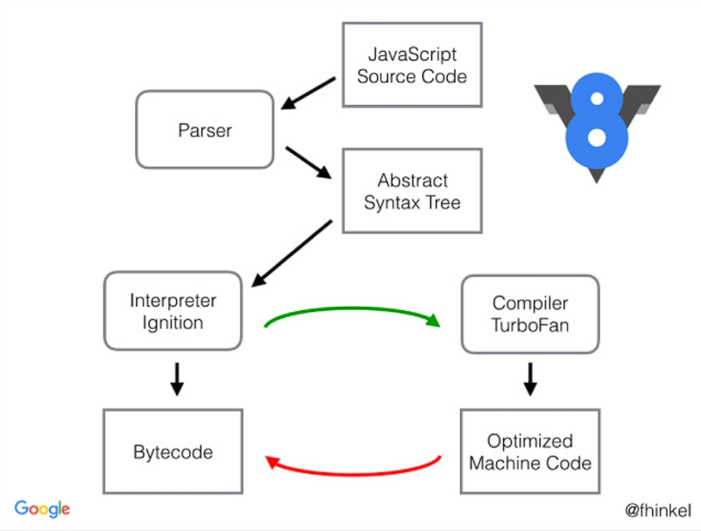

Slide 4


Slide 5


Slide 6


Slide 7


Slide 8
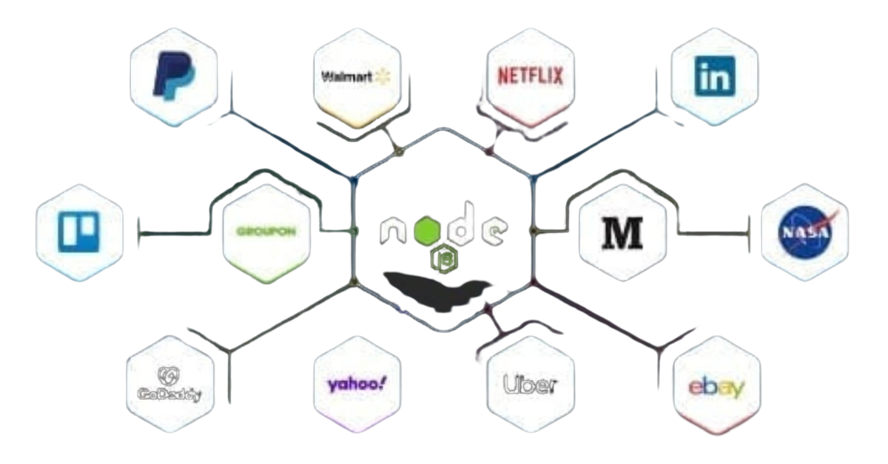

Slide 9
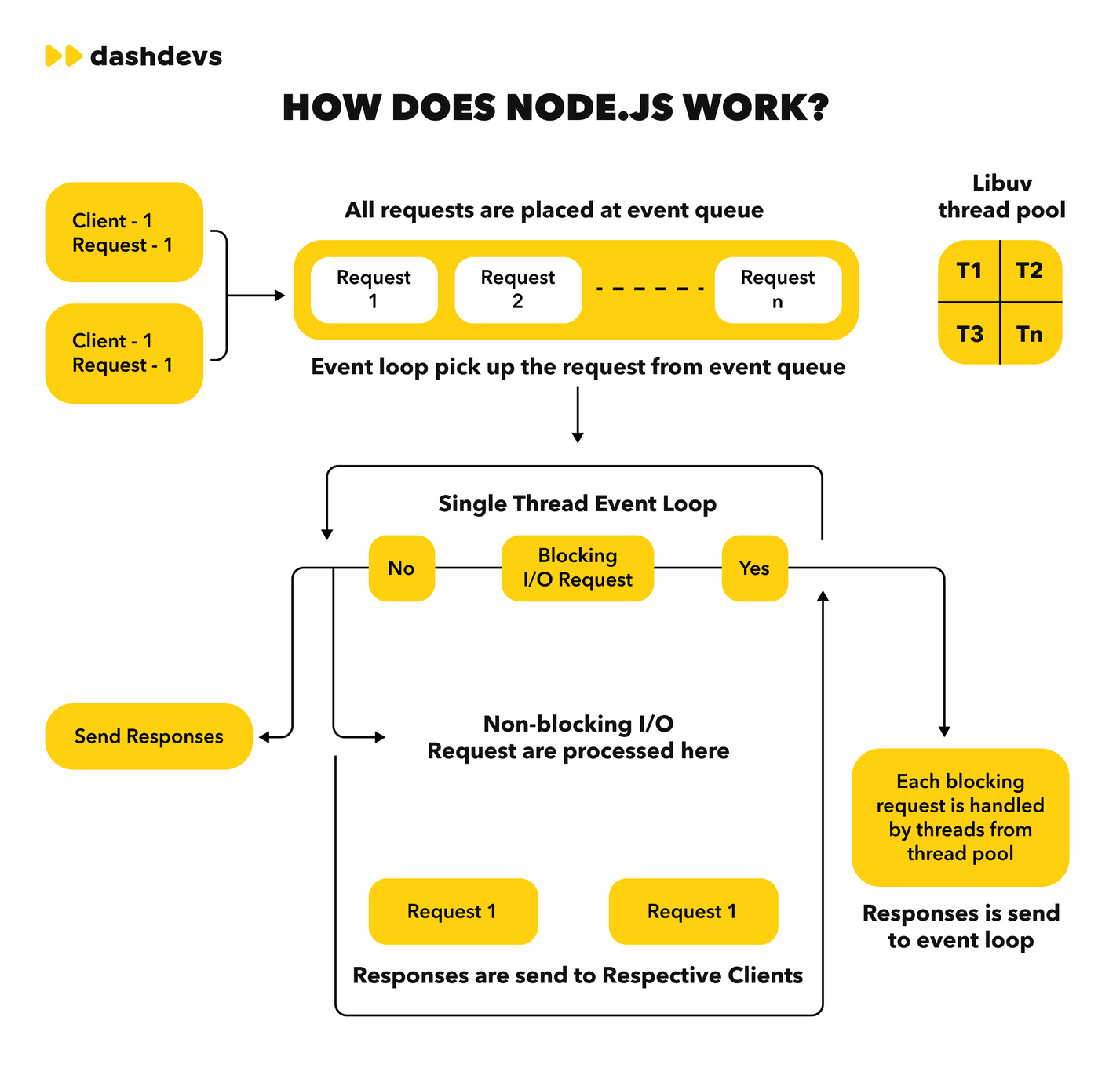

Slide 10
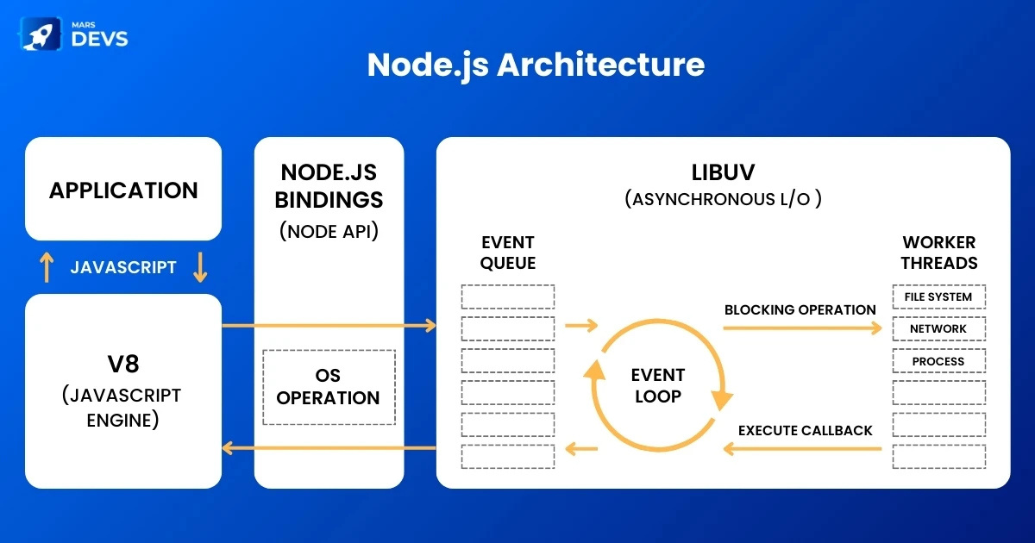

Slide 11

What About Javascript?

